Slide 1
Technological Choice Module
Socio-technical systems as constraining organizational environments
Dr. William Frey
ADMI 4016

Slide 2
Prepare a Socio-Technical System (STS) table
“an intellectual tool to help us recognize patterns in the way technology is used and produced”
Components: Hardware, Software, Physical Surroundings, Stakeholders (people, groups, & roles), Procedures, Laws (Criminal Law, Civil Law, Statutes & Regulations), Information Systems (collecting, storing, transferring)
Other Components: Financial Markets, Rate Structure (Power Systems), Environment, Technological Context, Supply Chain
A STS is a system. The components are related and interact.
STSs embody values
Moral: Justice, Respect, Responsibility, Trust, Integrity
Non-Moral: Financial, Efficiency, Sustainability
STSs exhibit trajectories i.e., coordinated paths of change

Slide 3
1. Identify key components of the STS
Hardware | Software | Physical Surround-ings | Stakeholders (People, Groups, and Roles) | Procedures | Laws | Information Collection and Storage Structures

Slide 4
Steps to a STS analysis
1. Describe the software and hardware components of the socio-technical system.
2. Describe the physical environment(s) in the socio-technical system.
3. Who are the key stakeholders in the STS? What are their stakes? What are their roles?
4. Outline important procedures in the STS? Describe them step-by-step.
5. Describe the legal environment of the STS including general branches of the law, key laws, important regulations, and statutes.
6. How is information collected, stored, and disseminated in the STS?

Slide 5
More Steps
Are there any value conflicts in the STS?
What are the values?
Where are they located? (Under which components?)
Moral versus Moral? Moral versus Non-Moral? Non-moral versus Non-moral?
Are there any value vulnerabilities in the STS
What values are under threat?
Where are they located? (Under which components?)
Are there any harms latent or potential in the STS?
What is their magnitude? (Catastrophic or trivial?)
What is their likelihood or probability
What is the trajectory or path of change in the STS?
Is it positive or negative?

Slide 6
Technology: Hardware and Software
Technology includes hardware, software, designs, prototypes, products, or services.
Hardware in classroom 236 includes computer, data display projector, smart board.
Software would include PowerPoint, Word (Microsoft features) as well as software that runs smart board.
Technologies enable and constrain action
PowerPoint allows for picturing ideas
But it tempts us to read off the slides instead of talking with our audience
1. Describe the software and hardware components of the socio-technical system

Slide 7
Physical Surroundings
Describe the physical environment in a given STS
Geography, weather, landscape, flora, fauna, cities, forests, etc.
Physical surroundings embed values.
Fixed tables in 236 constrain group work while enabling listening.
236 clearly separates presenting (active) area from listening (passive) area.
Doors, by their weight, strength, material, size, and attachments (such as locks) can promote values such as security.
Physical surroundings promote, maintain, or diminish other values in that they can permit or deny access, facilitate or hinder speech, promote privacy or transparency, isolate or disseminate property, and promote equality or privilege.
Think about how the mountains in the center of Puerto Rico have shaped the community life of the pueblos located there
2. Describe the physical environment(s) in the socio-technical system

Slide 8
People, Groups, and Roles
These are often characterized as “constituyentes” or stakeholders
Any group or person with an essential interest at risk (at stake) in the situation at hand
Teachers, administrators, technical staff, and, of course, students are stakeholders of 236
What are their interests?
What are their roles?
How does these interest and role sets interact?
3. Who are the key stakeholders in the STS? What are their stakes? What are their roles?

Slide 9
Procedures
Relevant procedures to room 236
Setting up the class (turning on the equipment, setting the lights, positioning the podium, etc.)
Lecturing, discussing, taking exams, reading, are all pedagogical procedures that take place in room 236
Procedures can promote values or they can display value vulnerabilities
Recording grades online may place privacy in jeopardy if the storage place is not protected by encryption.
A grievance procedure may undermine due process rights if there are unreasonable time delays between steps in the procedure
4. Outline important procedures in the STS? Describe them step-by-step.

Slide 10
Laws, Statutes, and Regulations
Class attendance is required in the University’s Reglemento; faculty are required to hold a certain number of office hours per credit hour of teaching
Business (such as restaurants) are subject to safety regulations (OSHA), food preparation regulations (FDA), and legal regulations governing employee treatment (overtime requirements, minimum wage, maximum hours of work per week, minimum age requirements)
How these differ from one nation to another creates many problems for multinational corporations
Corporations are considered legal persons and have certain legal rights such as free commercial and non-commercial speech
Bankruptcy laws and legally mandated procedures
Legal requirement to form a bankruptcy committee composed of representative of creditors
5. Describe the legal environment of the STS including general branches of the law, key laws, important regulations, and statutes.

Slide 11
Information gathering, storage, and dissemination
Key issue in businesses that rely on computer technology
How does a company gather information on market conditions, suppliers, customers, competitors?
How does it store this information (In file cabinets behind locked doors?)
How does it transfer this information, to whom, and on what occasions?
Toysmart guaranteed that it would not transfer customer financial information to third parties. This promise aided it in collecting this information. They promised secure (say encrypted) methods for storing this information
6. How is information collected, stored, and disseminated in the STS?

Slide 12
STS and Problem Specification
Having a good STS description, highlighting its key values, and locating these values in components of the STS provide set the stage for problem specification
Identifying value conflicts, potential or latent harms, and negative trajectories in STS document and validate problem specification
In many cases, specifying the problem in reference to the STS also outlines potential solutions
A security vulnerability can be addressed by holistically adjusting elements of the STS; strengthening physical barriers, securing data, refining procedures and lobbying for new laws could represent adjustments to strengthen the security of a STS

Slide 13
Classify the problem:
Disagreement on Facts
Did the supervisor sexually harass the employee? (What happened—there are two different versions)
Disagreement on Concepts
Has the supervisor created a hostile environment? (Meaning of hostile environment?)
Conflicts
Conflict between moral values (Toysmart either honors property claims of creditors or privacy rights of customers)
Conflicts between moral and non-moral values (In order to get the chips to clients on time, LaRue has told the quality control team to skip environmental tests and falsify results)
A key value becomes vulnerable
Online activity has magnified the potential harms of cyberslander against companies like Biomatrix
Immediate, Midterm, or Remote Harms
Is it the case that Therac-25 patients are receiving radiation overdoses?

Slide 14
Table summarizing problem classification (With Generic Solutions)
Problem / Solution Strategy | Disagreement |  | Value Conflict | Value Vulnerability | Impending harm | Situational Constraints
 | Factual | Conceptual | Values exclusive | A value is vulnerable | Harm is possible | Limits
 | Collect information Weigh competing witness accounts Perform controlled experiments | (Use Authority such as law or regulation) Conceptual analysis (criticize competing definitions) Draw analogies with past cases | Fully integrate conflicting values? Partially realize and integrate conflicting values? Keep one value, drop others (Tradeoff)? | Strengthen value in its current location Adjust STS so that different parts comple-ment one another | Take action to prevent harm Notify potential victims Make sure risk is acceptable to all parties involved | Resource? Technical? Interest?

Slide 15
3. Responsible Technological Choice
Students learn about Socio-Technical Systems
Developing cognitive skill of techno-social relevance
Students assigned cases of technological choice
For case studies on technological choice, see:
Johnson and Wetmore, Technology and Society: Building Our Sociotechnical Future, MIT Press, 2009

Slide 16
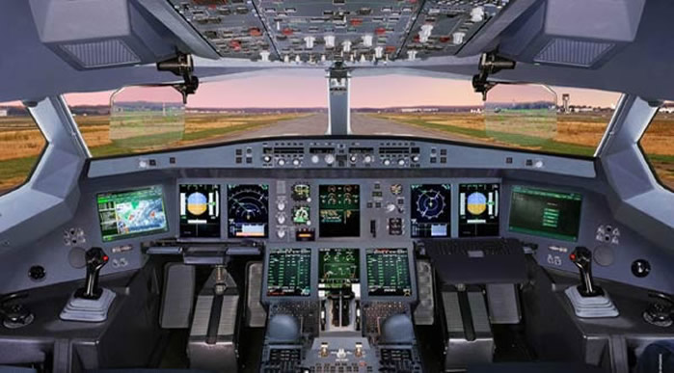
Responsive Technological Choice: Case 1
Redesigning airplane cockpits to
remove gender bias
Restoring interpretive flexibility
on a widely accepted and used
Design (=transpectivity)
Empowering participation of
citizens interest groups in
technological design
(=participatory standpoint)
http://www.aviationexplorer.com/a350_facts.htm
Manufacturing Gender in Commercial and Military Cockpit Design
Rachel N. Weber
Science, Technology, & Human Values, Vol. 22, No. 2. (Spring, 1997), pp. 235-253.
http://www.jstor.org Tue Jan 2 16:14:06 2007

Slide 17
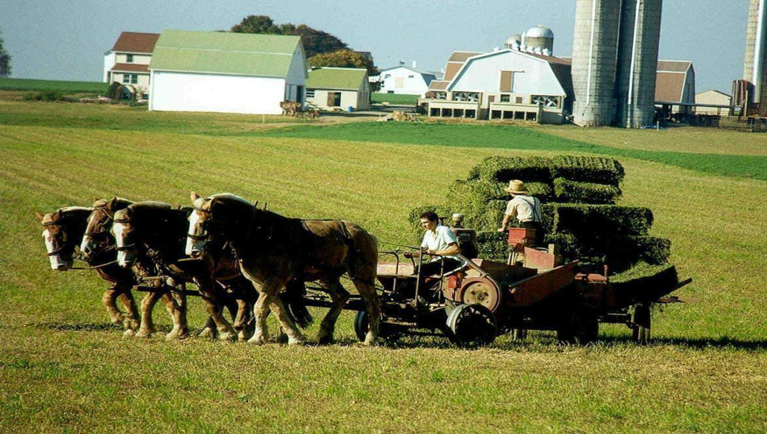
Responsive Technological Choice: Case 2
How the Amish adopt and adapt technology
Using technological choice to build a
community’s identity
Assessing how a technology would impact a
community’s core values
Modifying existing technology to minimize
negative impact on a community’s values
http://amishbeat.wordpress.com/
Jamison Wetmore. “Amish Technology: Reinforcing Values and Building Community” in Technology and Society, eds. Johnson and Wetmore. 2009, MIT Press: 298-318

Slide 18
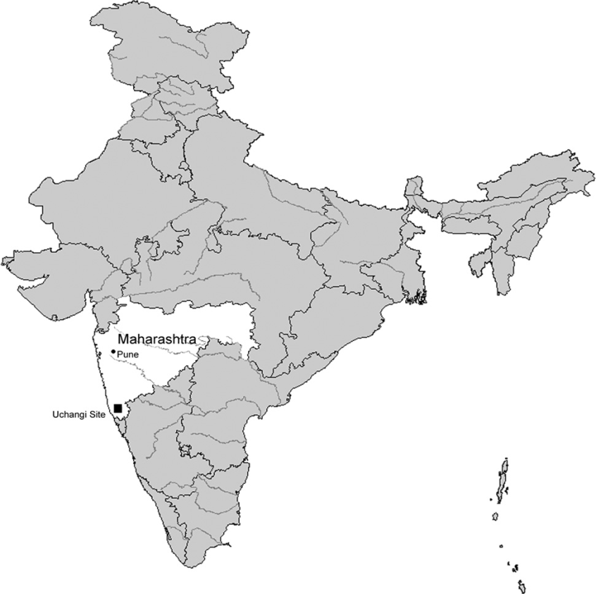
Responsive Technological Choice: Case 3
Bridging the gap between government and local
communities in the Uchangi Dam Project
How engineers and other professionals with
NGOs can serve as mediators or honest
brokers in disputes on technological choice
Professionals work with local
communities to “give them voice.”
Roopali Phadke. “People’s Science in Action: The Politics of Protest and Knowledge
Brokering in India.” In Tecnology and Society, Johnson and Wetmore eds. MIT Press, 2009, 499-513.

Slide 19
Case | Relevance (technological) | Response (technological)
Amish Choice of Technology | Impact on community core values, solidarity, and identity | Rejecting technologies that violate community standards; Modifying technologies to resonate with community standards
Redesigning airplane cockpits for women | Discovery of gender bias embedded in cockpit design (questioning assumptions to restore interpretive flexibility) | Organizing lobbying efforts to convince stakeholders to redo cockpit design to resonate with women’s capabilities
Reconfiguration of Uchangi irrigation project | Uchangi dam as posed by government requires relocating two villages (restoring interpretive flexibility via transperspectivity) | NGO engineers create opportunity for local communities to build values into credible, competing irrigation project designs

